Slide 1
Case Study – Text Mining Bank Reviews-Complaints Analysis

Slide 2
Agenda
Business context and objective
Data understanding and audit
Exploratory Analysis
Data pre-processing
Classification into Positive/Negative/Neutral
Predicting star ratings using reviews
Key Positive/Negative words
Topic Modelling and Intent analysis
Topic modelling with Gensim’s LDA
K-Means Clustering
Conclusion

Slide 3
Business problem
Business Context:
Central banks collect information/feedback/complaints from customers on different services provided by different banks.
1. Bank users give ratings and reviews to the services on bank website. These ratings are useful to the banks in evaluating their services and take necessary action to improve their services. Ratings help the banks understand the overall experience but they do not convey the context which led the reviewer to that experience.
2. If we look at the rating alone, it is difficult to gauze why the review gave a 4 or a 2 start rating. But, if we read the review it is not difficult to understand that the reviewer talks about good service/bad service/expectations.
Objective:
The objective of this case study is to analyze customer reviews and predict customer satisfaction with the reviews. Also, identify key themes of the problems.
Approach:
Data Processing
Key positive words, negative words (most frequent words)
Classification of reviews into positive, negative and neutral
Identify key themes of problems (using clustering/topic models)
Predicting start ratings using reviews
Perform intent analysis

Slide 4
Data understanding and Audit
Data provided to us was a dump of customer reviews/complaints utilizing various services.
There were 505 reviews/complaints.
We have 4 variables – 2 with text, 1 categorical, 1 date.
Below are details provided in the dataset:
Date (datetime) – Date the review was posted
Stars (int64) – 1 -5 rating for the business
Reviews (object) – Review or complaint text
BankName (object) – Name of the bank reviewed
There are only 2 distinct values for variable ‘Stars’, 1 and 5.
Renaming columns appropriately – no name change is required
Check data types - Done
Check for missing values – Done, no missing values
Check for duplicates – Done, 2 duplicates found and dropped
Any type conversion required - not required

Slide 5
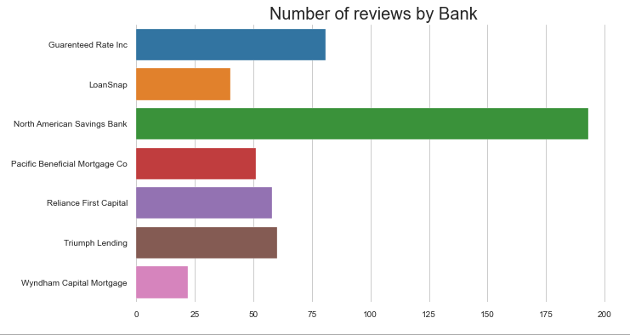
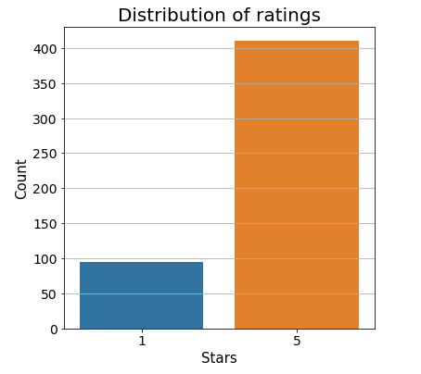
Exploratory Analysis
North American Savings bank has a little less than 50% of the total reviews.
We have only 1 or 5 star ratings in the data, 90% of the reviews are rated 5.

Slide 6
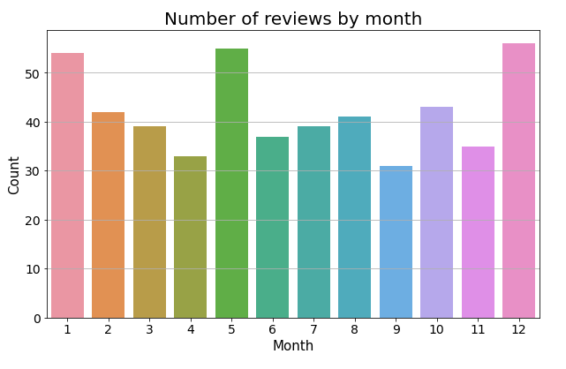
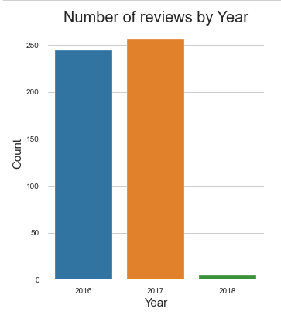
Exploratory Analysis
Number of customer reviews are highest during the months of December, January and May.
Per year wise distribution of the data, almost all reviews are from 2016 and 2017.

Slide 7
Data pre-processing
For the purpose of our analysis, we need the Reviews and Stars variables. The following text preprocessing items were run on the Reviews variable text data.
Removal of any web address
Regex: '(www\.[^\s]+)|(https?://[^\s]+)'
Removal of any email address
Regex: '\S*@\S*\s?
Removal of any numbers, within or standalone. This took care of any phone numbers as well.
Regex: '\d+'
Removal of new line characters.
Regex: '\s+'
Removal of special characters.
Regex: "[-()\"#/@;&:{}`+=~|.!?,'0-9]"
Removal of continuous spaces with 1 space character
Regex: ' +'
Move all characters to lower case.

Slide 8
Data pre-processing
Total word count in the corpus: 38577
Total unique word count in the corpus: 28451
Stop words were removed using NLTK’s English stop words list (nltk.corpus.stopwords.words('english’)).
Tokenization was done using NLTK’s word_tokenize function.
Part-Of-Speech (POS) tagging: we assigned a tag to every word to define if it corresponds to a noun, verb, adverb and adjective using the WordNet lexical database.
Lemmatization was done using NLTK’s WordNet lemmatizer to reduce the similar meaning words to their root form (e.g. rooms -> room, slept -> sleep)
After Lemmatization if a word was a two letter word, then was removed.
Ex. Went → go , go was removed
Spacy library was used to perform Named Entity Recognition to filter out the Person Names like ‘Kirk’, ‘James’ etc.. Entity name ‘PERSON’ was used to identify names within the corpus.
After pre-processing, lemmatization, stop word removal:
Total word count in the corpus: 623

Slide 9
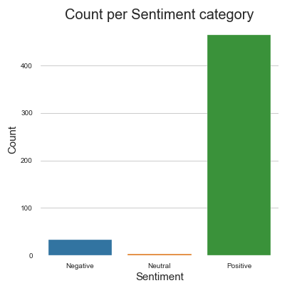
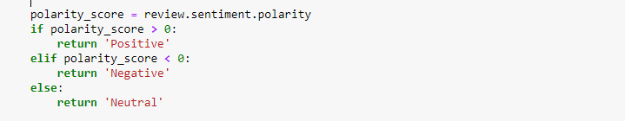
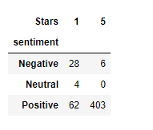
Classification into Positive/Negative/Neutral
To classify the reviews based on sentiment, that is, into Positive, Negative or Neutral reviews, we used TextBlob’s sentiment polarity scorer.
For this exercise the data was done, cleaning for special characters, numbers etc.. But, tokenization, removal of stop words or lemmatization was not done.
Following rule was followed for categorizing the reviews into Positive, Negative or Neutral categories:
Maximum number of reviews were classified as Positive, this was expected as over 400 out of 500 reviews were, 5 start reviews.
Since, all reviews in the data were either 1 start or 5 star, it was expected that neutral reviews would be close to zero.
There were certain mis-matches between the sentiment and star ratings, as can be observed from the cross-tab

Slide 10
Predicting star ratings using reviews
Model Building and execution
2 ML algorithms – Naïve Bayes and Extreme Gradient Boost were tried and we compared the Accuracy and ROC-AUC scores.
Both the above ML techniques were tried with CountVectorizer DTM and TfidfVectorizer TF-IDF.
Data was pre-processed including removal of stop words, tokenized, lemmatized.
Data was split into train and test. Model was built on train and validating on test before actual prediction.
Test to Train split was 30% and 70% .
Final tuning parameters for Naïve Bayes Multinomial classifier:
alpha=1.0, class_prior=None, fit_prior=True
Final tuning parameters for XGBClassifier:
gamma=1, learning_rate=0.01, max_depth=5, min_child_weight=1,
n_estimators=1000, n_jobs=-1, random_state=42, verbose=1

Slide 11
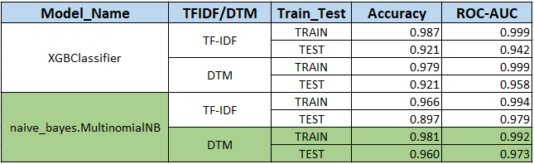
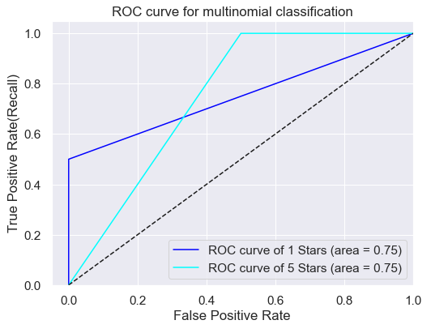
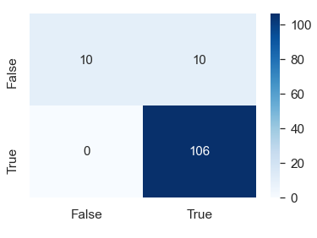
Predicting star ratings using reviews
Model Comparison
Finalized Model:
We chose Naïve Bayes with DTM with over other models.
Accuracy score was better on test data for NB with DTM though ROC scores were similar for both classifiers.
Naïve Bayes was faster.
Below are confusion matrix and roc plot for Naïve Bayes on test data.

Slide 12
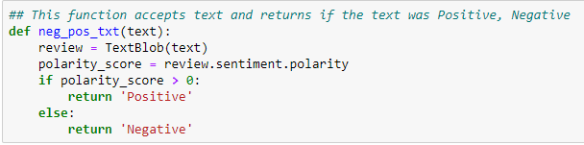
Key Positive/Negative words
To classify the words in review text based on sentiment, that is, into Positive or Negative, we used TextBlob’s sentiment polarity scorer.
For this exercise the data cleaning was done for special characters, numbers etc..
Also, tokenization, removal of stop words or lemmatization was done.
Following rule was followed for categorizing the reviews into Positive, Negative or Neutral categories:
After the tokenization and lemmatization, we created a DTM with CountVectorized and used the terms to process them for negative or positive words.

Slide 13
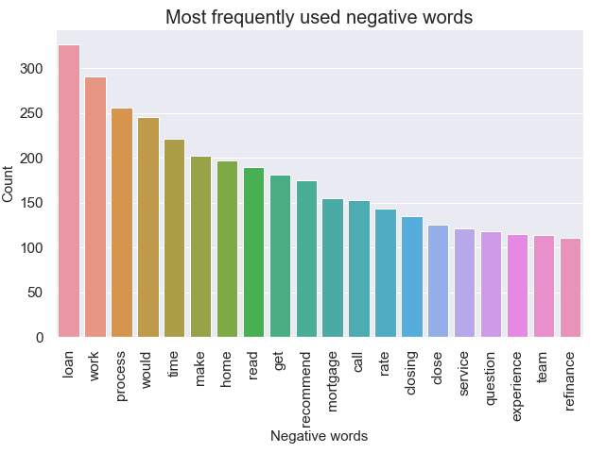
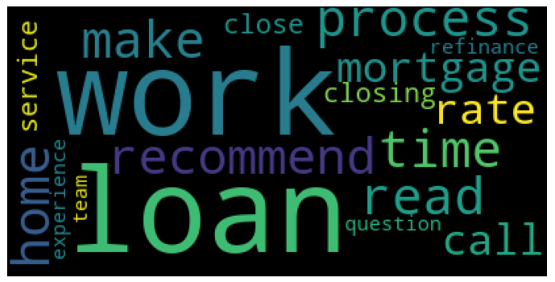
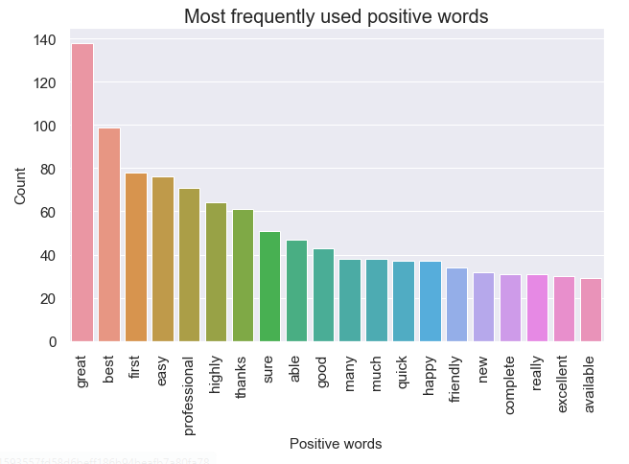
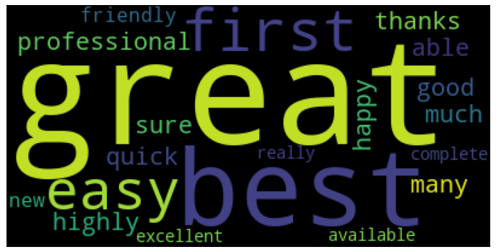
Key Positive/Negative words

Slide 14
Topic Modelling and Intent analysis
To identify key themes of the reviews/complaints, we utilized topic modelling and intent analysis with the following unsupervised learning algorithm techniques:
Topic modelling with Gensim’s LDA
Segmentation using Kmeans clustering.
With Topic modelling we aim to automatically discover the hidden thematic structure in our corpus of text documents i.e.. Review text by classifying terms into topics, this is also called soft clustering.
The Gensim’s LDA technique give us a list of topics, each represented as a list of term along with the weights for the terms as well.
With Kmeans, we are trying to segment the documents based on similarity i.e. classifying them into clusters. The cluster would yield top terms which could be used for identifying the themes of reviews and complaints.
For this exercise the data cleaning was done for special characters, numbers etc..
Also, tokenization, removal of stop words or lemmatization was done.
All the techniques were used with TFIDF matrix.

Slide 15
Topic modelling with Gensim’s LDA
We analysed the nature of jobs by using the Gensim’s LdaModel class to execute the unsupervised learning technique of Latent Dirichlet Allocation(LDA) on the ‘Reviews’ data column.
With Topic modelling we aim to automatically discover the hidden thematic structure in our corpus of text documents i.e.. Reviews text, in our case, by classifying terms into topics, this is also called soft clustering.
The Gensim’s LDA technique give us a list of topics, each represented as a list of terms along with the weights for the terms as well.
For this exercise the data cleaning was done for special characters, numbers etc..
Also, tokenization, removal of stop words or lemmatization was done.
Lemmatization was done with POS tagging and restricting the words to NOUN, ADVERB, ADJECTIVE and VERB.
After Lemmatization if a word was a two letter word, then was removed.
Ex. Went → go , go was removed
Spacy library was used to perform Named Entity Recognition to filter out the person names like ‘Kirk’, ‘James’ etc.. Entity name ‘PERSON’ was used to identify names within the corpus.
We built 4, 5, 6, 7 and 8 topic LDA models and qualitatively analysed the results.
We chose the 5 topic model as it gave the best interpretability and looking at pyLDAvis outputs, the 5 topics gave a the least overlap.

Slide 16
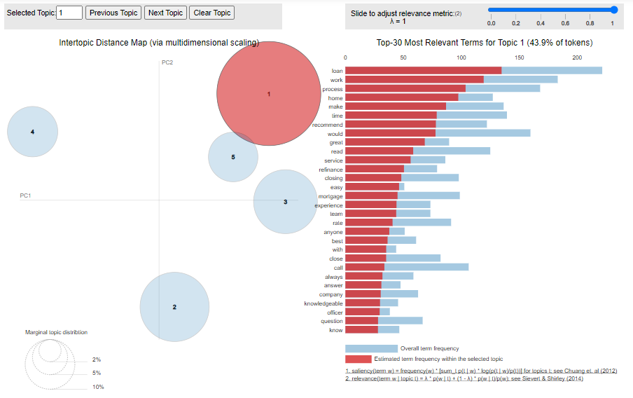
Topic modelling with Gensim’s LDA
pyLDA visualization for 5 topics model gave least (topics 1 and 5 have a slight ) overlap – which is good. Topic numbers in pyLDAvis start from topic no. from LDA model + 1.

Slide 17
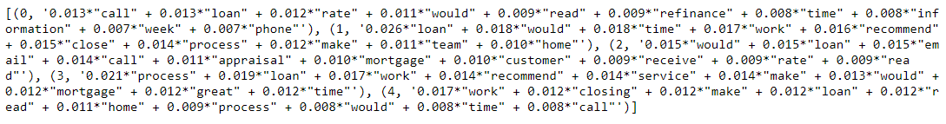
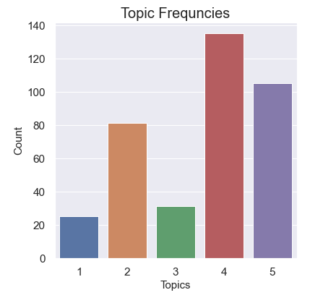
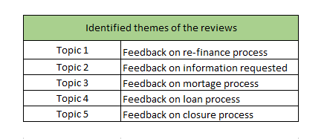
Topic modelling with Gensim’s LDA
Result of topic modelling:

Slide 18
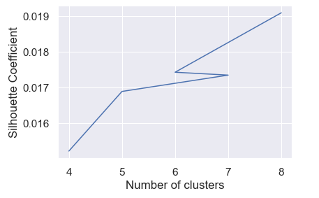
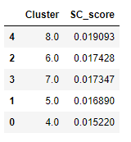
K-Means Clustering
To understand the global dominant theme in the documents, we performed K-Means segmentation using the ‘Reviews’ column.
This is a unsupervised learning technique which tries to classify documents into topics based on Euclidian distance.
The data from ‘Reviews’ column was pre-processed, including lemmatization, name removal etc., as has been described earlier.
Based on clear distinctions within the clusters, interpretability and distribution within the clusters, we chose the K=5 as the final solution although the Silhouette score was low compared to other cluster solution.

Slide 19
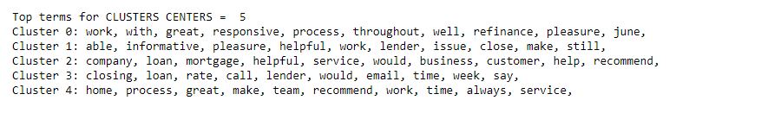
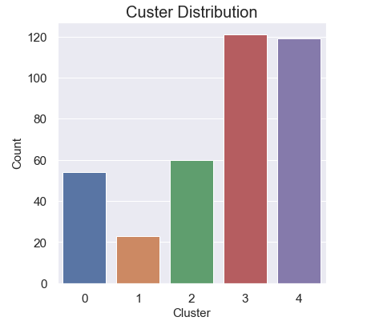
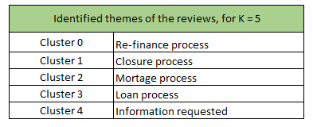
K-Means Clustering
We calculated the top terms in the cluster solutions by calculating the proximity to the cluster centroids.

Slide 20
Conclusion
This text mining project shows that by pre-processing and analysing the unstructured customer reviews data we can get valuable insights into customer sentiments and intent.
By applying polarity scores we were able classify review sentiments appropriately. This enables the business to see the impressions of the customers and how and how effective their service is at increasing satisfaction.
Again by using polarity scores, we were able to successfully come up with the top vocabulary for negative and positive sentiments.
We used supervised learning techniques of Naïve Bayes and Extreme Gradient Boost to predict review ratings with almost 98% accuracy. Sometimes, the rating is very disproportionate to the review. This certainly is a great impact on the business. Hence, our model can be used to assign the right star rating based on the review text and lessen the number of such disproportions.
By application of LDA statistical model, we were able to come up with the main review ‘topic’.
With K-Means clustering, we created a understanding of the customer’s intent towards feedback and review.

Slide 21
Thank You !

